Slide 1


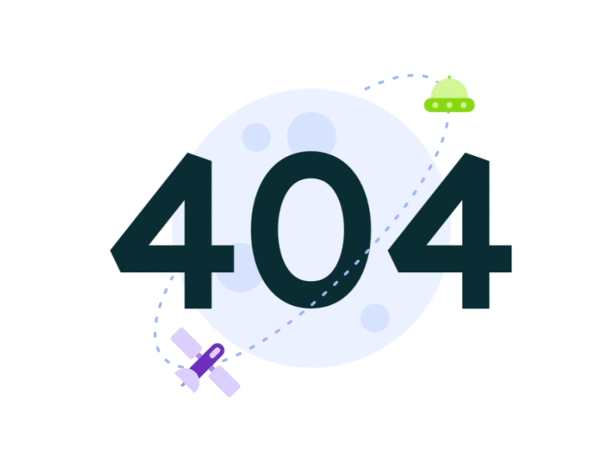
Managing Big Data :
Amazon Comprehend & NLP
with Amazon Reviews

Slide 2

Hello,
We are Team 404
Comprised of Frank Fan, Carl Xi, Yaping Zhang and Jie Zhu

Slide 3
Presentation Overview
Frank
Frank
Frank
Carl
Carl
Jie
Yaping
Amazon Comprehend Overview
Amazon Comprehend Demo
Data Understanding
Sentiment Irregularities
Cross-Category Sentiment Analysis
User
Analysis
Comparison with TextBlob

Slide 4

1. Amazon Comprehend Overview
1
2
3
4
5
6
7

Slide 5
1
2
3
4
5
6
7
Amazon Comprehend is a natural language processing (NLP) service that uses machine learning to discover insights from text.

Slide 6
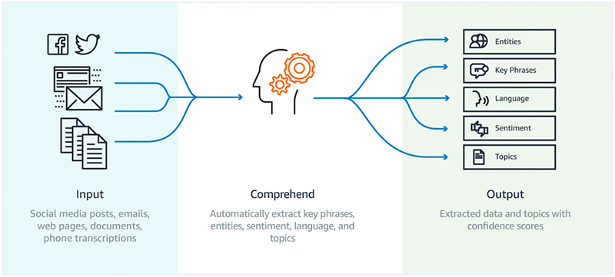
How does it work:
Amazon Comprehend uses a pre-trained model to examine and analyze a document or set of documents to gather insights about it. This model is continuously trained on a large body of text so that there is no need for you to provide training data.
1
2
3
4
5
6
7

Slide 7
Features
1
2
3
4
5
6
7
Keyphrase Extraction
Amazon Comprehend extracts key phrases that appear in a document. For example, a document about a basketball game might return the names of the teams, the name of the venue, and the final score.
Detect the Dominant Language
Amazon Comprehend identifies the dominant language in a document. Amazon Comprehend can identify over 100 languages.
Entity Recognition
Amazon Comprehend returns a list of entities, such as people, places, and locations, identified in a document.
Sentiment Analysis
Amazon Comprehend determines the emotional sentiment of a document. Sentiment can be positive, neutral, negative, or mixed.

Slide 8
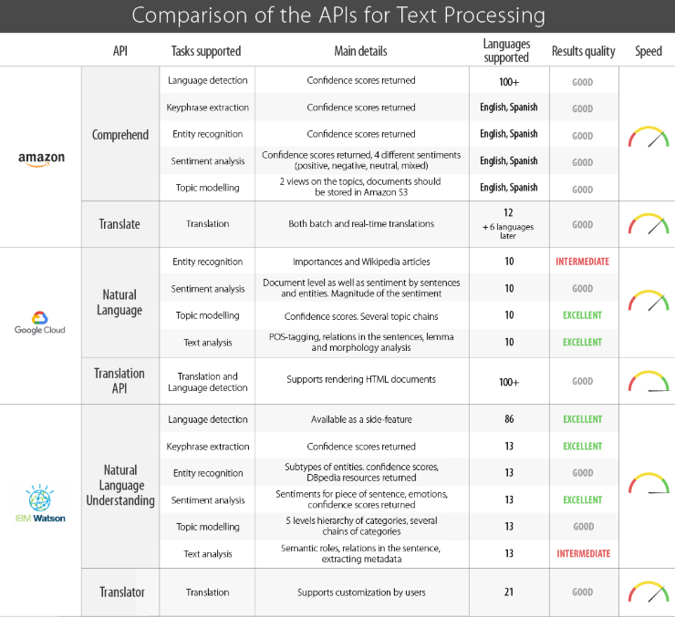
Comparison of the APIs for NLP
1
2
3
4
5
6
7
· Amazon Comprehend
· Google Cloud Analytics
· IBM Watson Natural Language Classifier

Slide 9

2. Amazon Comprehend Demonstration
1
2
3
4
5
6
7

Slide 10
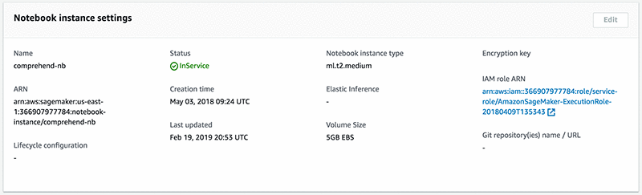
Getting Started
1
2
3
4
5
6
7
Step 1: Set up your Amazon SageMaker notebook
From the AWS Management Console, choose Services and then Amazon SageMaker under Machine Learning, and in the Amazon SageMaker console, under Notebook, choose Notebook instances. Now choose the Create Notebook Instance. And, in the console, under IAM(Identity and Access Management) role, choose Create a new role.

Slide 11
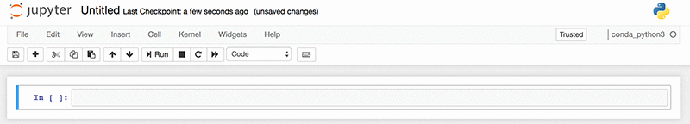
Getting Started
1
2
3
4
5
6
7
Step 2: Attach policies
From the IAM dashboard, choose Attach policies.
Step 3: Create a notebook
After you open the notebook instance that you provisioned, from the Jupyter console, choose New and then conda_python3.

Slide 12
Getting Started
1
2
3
4
5
6
7
Step 4: Connect to Amazon Comprehend
Then we can use the AWS SDK for Python SDK (Boto3) to connect to Amazon Comprehend from your Python code base. Boto is the Amazon Web Services (AWS) SDK for Python. It enables Python developers to create, configure, and manage AWS services, such as S3 and Amazon Comprehend. Using the following command, we import boto3 and connect to Amazon Comprehend in a specified AWS Region using the boto3 client.
import boto3
comprehend = boto3.client('comprehend',region_name='us-east-1')

Slide 13
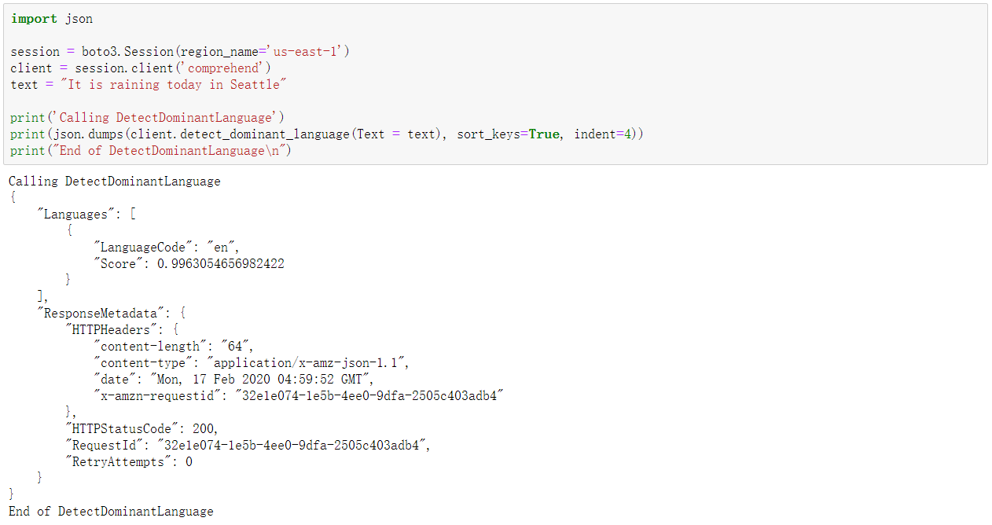
Detect the Dominant Language
1
2
3
4
5
6
7
Amazon Comprehend can automatically identifies text written in over 100 languages and returns the dominant language with a confidence score to support that a language is dominant.

Slide 14
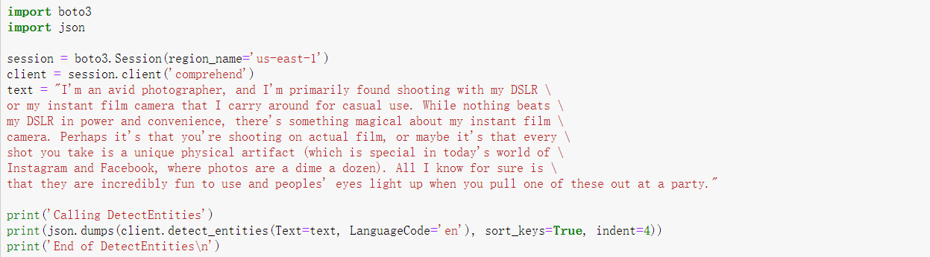
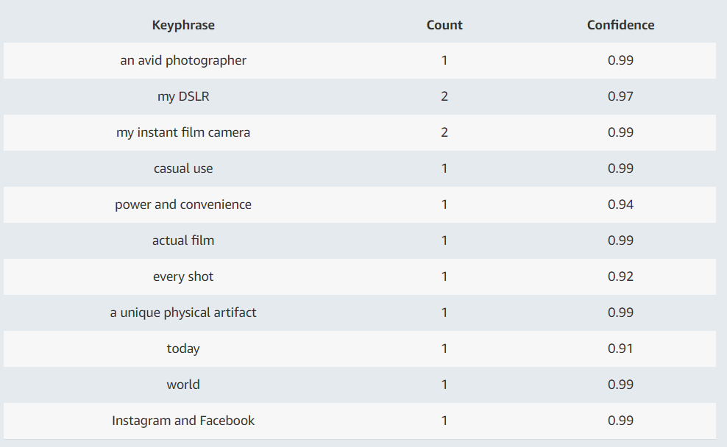
Keyphrase Extraction
1
2
3
4
5
6
7
Amazon Comprehend returns the key phrases or talking points and a confidence score to support that this is a key phrase.

Slide 15
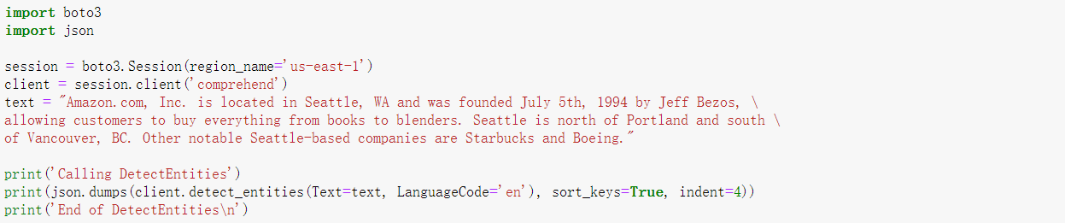
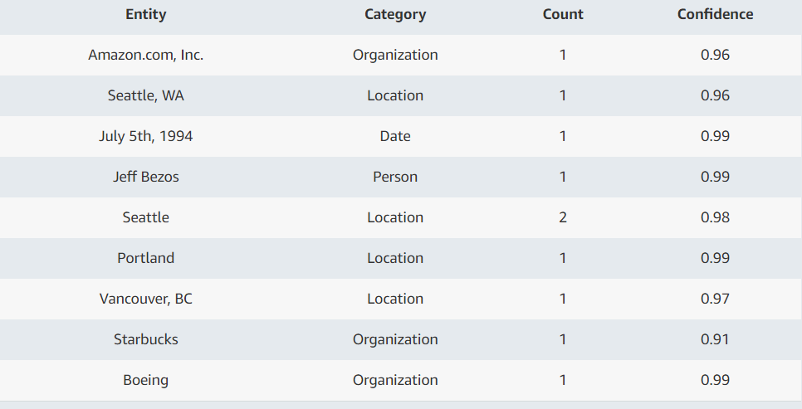
Entity Recognition
1
2
3
4
5
6
7
The Entity Recognition API returns the named entities ("People," "Places," "Locations," etc.) that are automatically categorized based on the provided text.

Slide 16
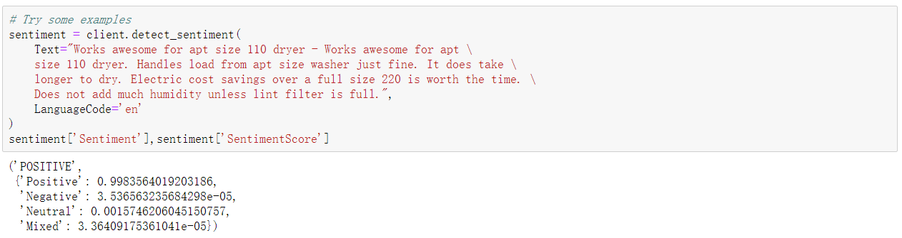
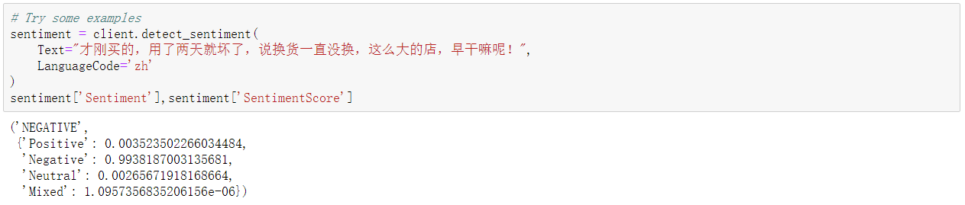
Sentiment Analysis
1
2
3
4
5
6
7
The following Python program detects the sentiment of input text. You must specify the language of the input text.

Slide 17
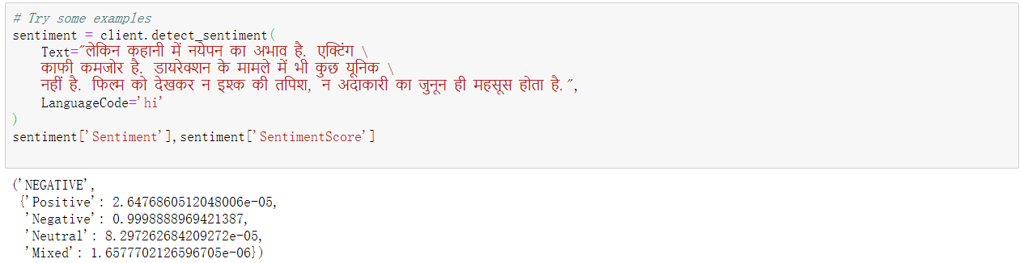
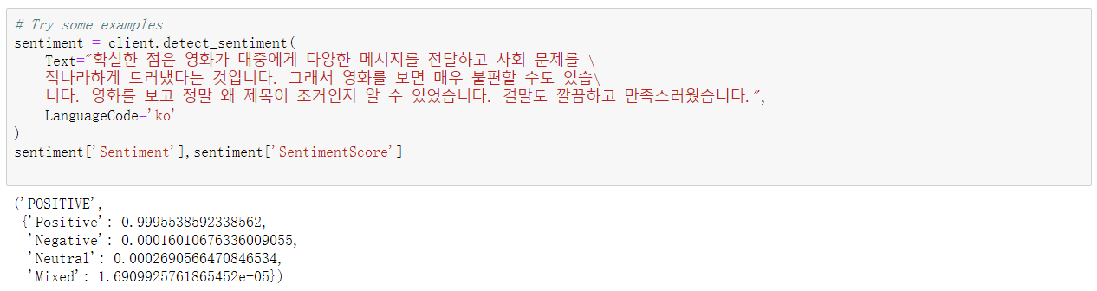
Sentiment Analysis
1
2
3
4
5
6
7
The following Python program detects the sentiment of input text. You must specify the language of the input text.

Slide 18

3. Data Understanding
1
2
3
4
5
6
7

Slide 19
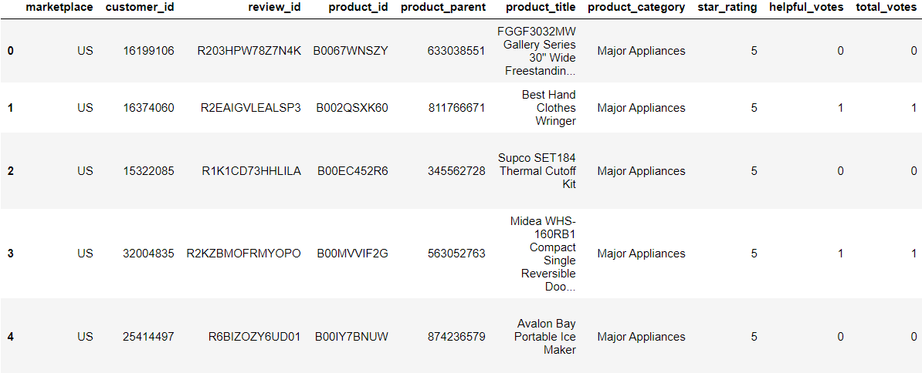
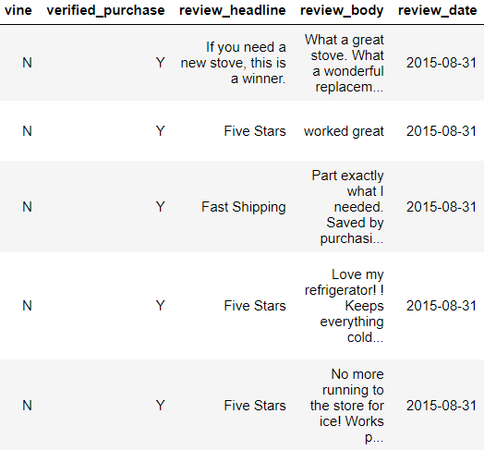
Amazon Customer Reviews:
Amazon Customer Reviews (a.k.a. Product Reviews) is one of Amazon’s iconic products. In a period of over two decades since the first review in 1995, millions of Amazon customers have contributed over a hundred million reviews to express opinions and describe their experiences regarding products on the Amazon.com website. Over 130+ million customer reviews are available to researchers as part of this dataset.
1
2
3
4
5
6
7
* Amazon Vine invites the most trusted reviewers on Amazon to post opinions about new and pre-release items to help their fellow customers make informed purchase decisions. Amazon invites customers to become Vine Voices based on their reviewer rank, which is a reflection of the quality and helpfulness of their reviews as judged by other Amazon customers.

Slide 20

4. Sentiment Irregularities
1
2
3
4
5
6
7

Slide 21
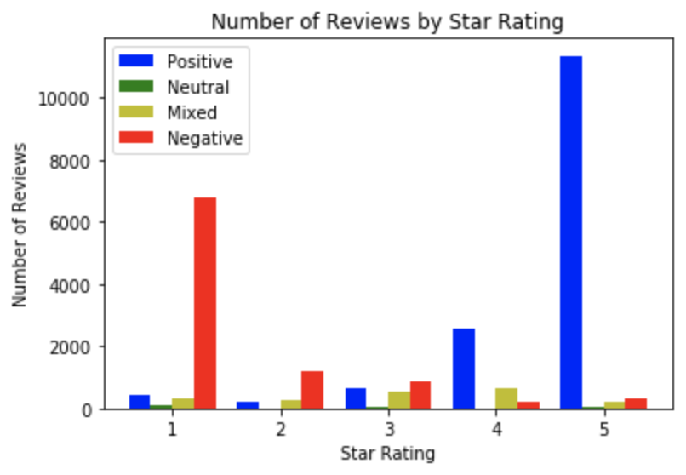
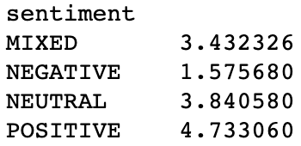
Overall Star Rating Distribution
1
2
3
4
5
6
7
Average Star Rating:
3.8853
Average Star Rating by Sentiment:
Positive-Negative Inflection Point occurs
around 3.

Slide 22
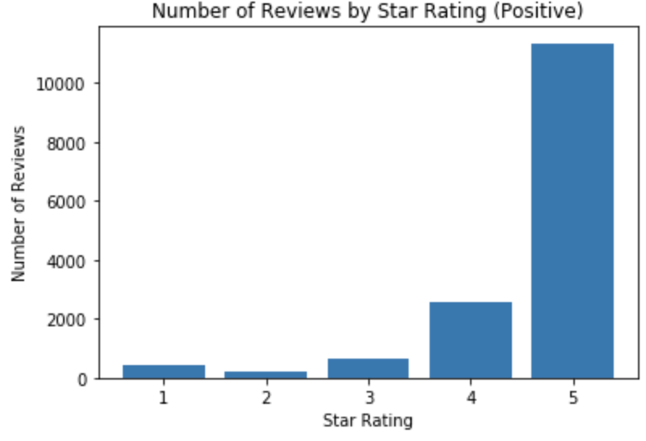
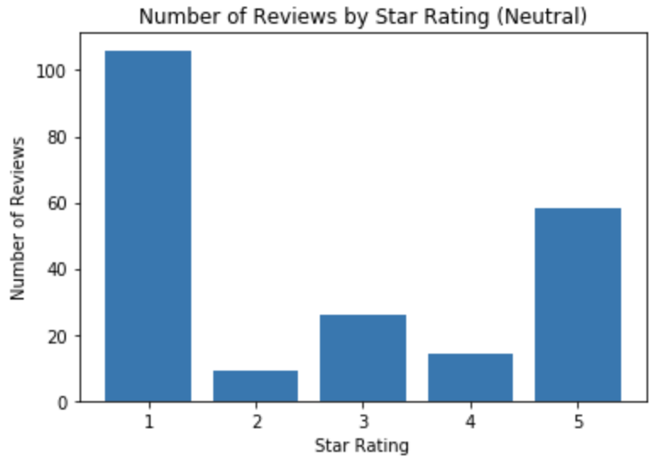
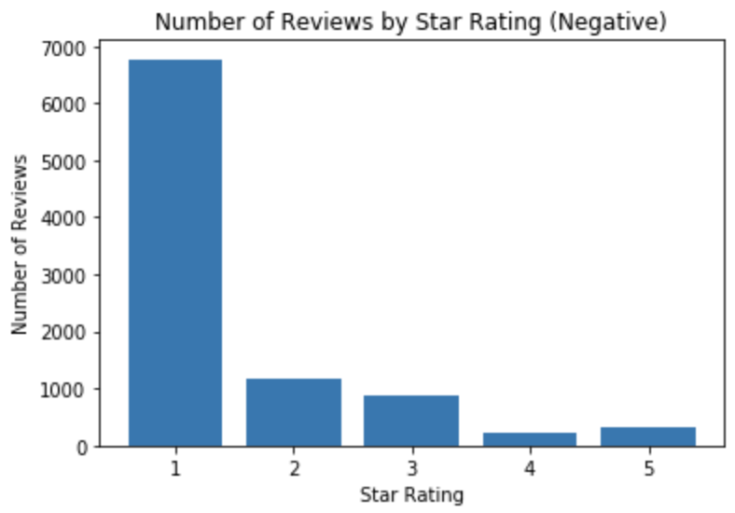
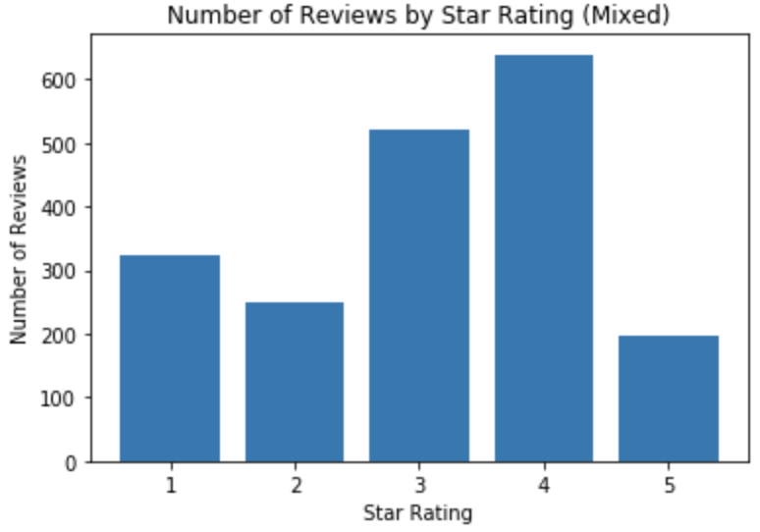
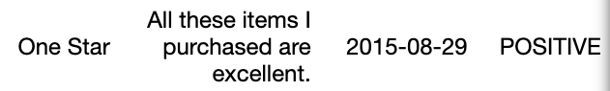
Rating Distribution by Sentiment
1
2
3
4
5
6
7
Observation:
Unusual occurrences (high star negative reviews / low star positive reviews) likely due to human error upon closer inspection.
Example:
Rating Comment Date Sentiment

Slide 23

5. Cross-category Sentiment Analysis
1
2
3
4
5
6
7

Slide 24
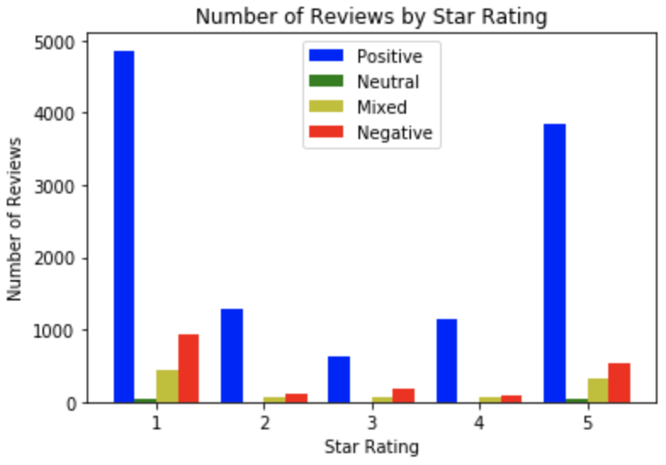
Rating Distribution Comparison:
1
2
3
4
5
6
7
Major Appliances: Video Games:

Slide 25
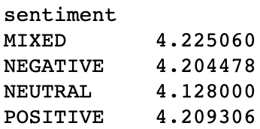
Rating Comparison
1
2
3
4
5
6
7
Average Star Rating Comparison: Star Rating becomes unreliable for
3.8853 - Major Appliances products that change over time:
4.2039 - Video Games Video Games: Major Appliances:
Rating Expectations greatly vary depending on product category
This could be due to various factors, such as:
availability of choice (20,000 racing games vs 5 washing machines)
ease of review (finding scratches on product vs visual glitch in game)
tolerance level (you can restart a game but not a product)

Slide 26
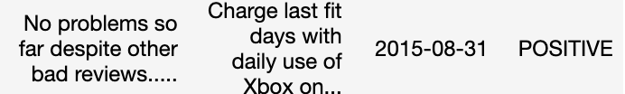
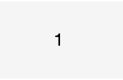
Adjustable Ratings:
1
2
3
4
5
6
7
Digital Release Items
Seller follows up following bad rating with remedy action, causing review/rating to alter. User may forget to change either/both.
Example:
Rating Comment Date Sentiment
Alternatively, some products (e.g. digital releases) can change over time.
Result: Unreliable ratings that require further analysis

Slide 27
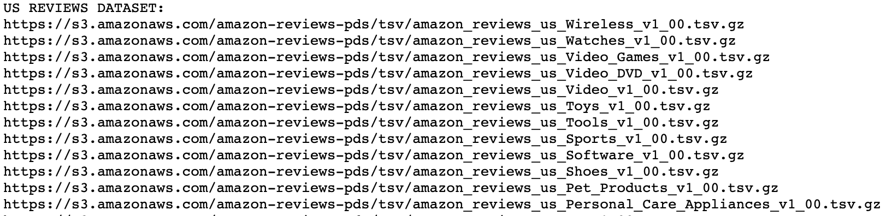
Further Analysis
1
2
3
4
5
6
7
Cross-Category comparison will become very interesting when done at scale
Reviews can be adjusted based per-category to better reflect reality
Analyse review and sentiments by customer profiling (Jie)
We are constrained by our budget on this project:
Every ~10,000 lines costed roughly 6-7 USD for Amazon Comprehend to process

Slide 28

6. User Analysis
1
2
3
4
5
6
7

Slide 29
Data Used
1
2
3
4
5
6
7
Index Page: https://s3.amazonaws.com/amazon-reviews-pds/tsv/index.txt
Datasets:
46 US review datasets
5 multilingual review datasets
4 US review datasets used
Major Appliances
Furniture
Watches
Musical instruments
2,752,353 rows initially
27,106 rows after (customer id with more than 30 reviews)
569 unique customers

Slide 30
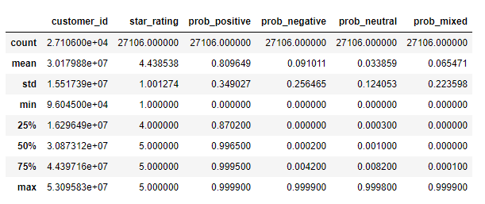
Overview
1
2
3
4
5
6
7

Slide 31
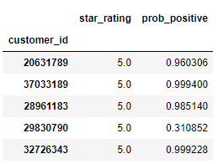
Highest Star-Rating Givers
1
2
3
4
5
6
7
Among all 569 customers with more than 30 reviews:
Highest star-rating is 5 stars
51 customers always give 5 stars
Most 5-star raters have also very high average positive sentiment probability
Some customers have low positive sentiment probability
They rate 5-star even when they are not satisfied

Slide 32
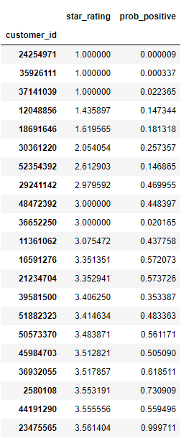
Lowest Star-Rating Givers
1
2
3
4
5
6
7
Among all 569 customers with more than 30 reviews:
Lowest star-rating is 1 star
3 customers always give 1 star
Most low-star raters have also low average positive sentiment probability
Some customers have very high positive sentiment probability
They rate low even when they are satisfied OR
They are being polite in the review section

Slide 33
Toxic Star-Rating Givers
1
2
3
4
5
6
7
Among 3 customers with all 1-star reviews:
Customer 24254971 only reviewed watches
Customer 35926111 only reviewed watches
Customer 37141039 only reviewed furniture, only mattress in particular
Their reviews are all without Verified Purchase
It could be that they are very picky about watches and mattress
OR
They are giving 1-star on purpose

Slide 34
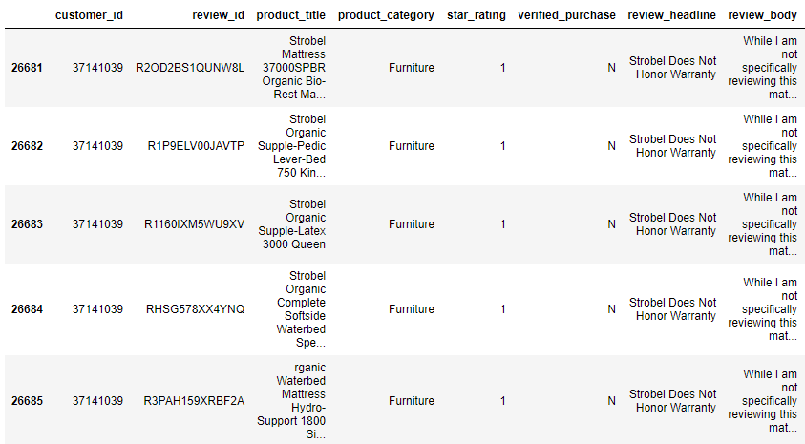
Toxic Star-Rating Givers
1
2
3
4
5
6
7

Slide 35
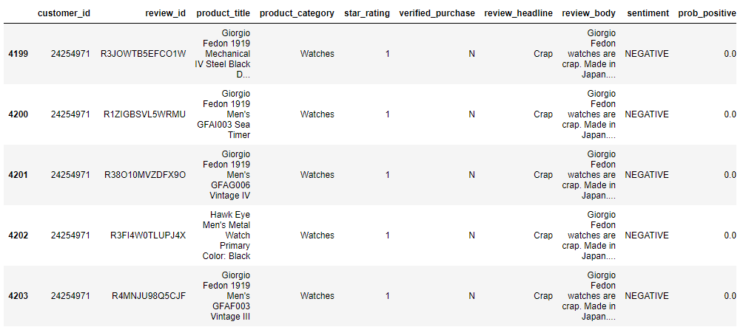
Toxic Star-Rating Givers
Toxic Star-Rating Givers
1
2
3
4
5
6
7

Slide 36
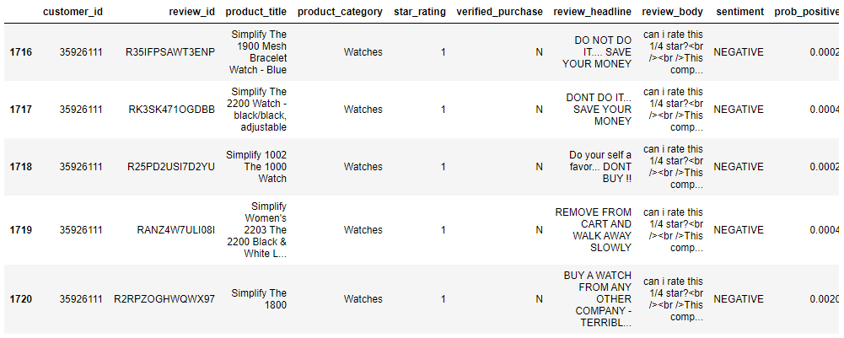
Toxic Star-Rating Givers
1
2
3
4
5
6
7

Slide 37
Toxic Star-Rating Givers
1
2
3
4
5
6
7
can i rate this 1/4 star?
This company is in the business of discounting their (absolute BS) $200 watch down so you think you getting a good deal. In actuality they sell you a terribly constructed piss poor product. Im pretty sure they are trying to knock off a chinese knock off of a american made watch. THATS TWO KNOCK OFFS. Watch broke after 1 month. 1 e'Fing MONTH!!?!?!? Absolutely fell apart. I emailed customer service and they told me i could buy a replacement and they wouldn't do anything for me. Sorry but when i buy products i expect them to last AT LEAST more than a month of gentle wear (office job). Terrible company, terrible watch.<br /><br />Honestly you’ll have better luck putting a quarter in the machine at walmart and getting the little pill bottle watch. At least that one will last.

Slide 38
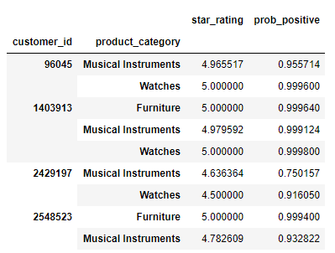
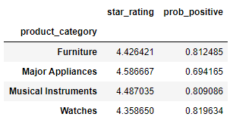
Customer Reviews in Multiple Categories
1
2
3
4
5
6
7
Include only customers with more than 30 reviews in 2 or more categories
285 customers
14,442 rows

Slide 39
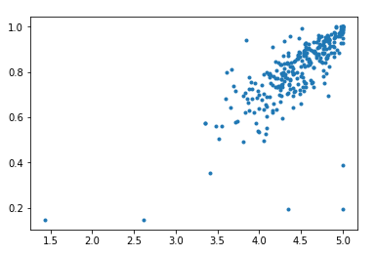
Star-Sentiment Plot
1
2
3
4
5
6
7
Average
Easily -Satisfied
Hard-to-Satisfied
5-Star Giver
Grumpy

Slide 40

7. TextBlob
1
2
3
4
5
6
7
A Python (2 and 3) library for processing textual data. It provides a simple API for diving into common natural language processing (NLP) tasks

Slide 41
More tools for NLP
1
2
3
4
5
6
7
· NLTK
· Spacy
· Stanford Core NLP
· TextBlob
· TextBlob:
Easier to use because it has nicer user interface
Documentation is thoroughly explained
Built on the shoulders of NLTK

Slide 42
Features of TextBlob
1
2
3
4
5
6
7
Noun phrase extraction
Part-of-speech tagging
Sentiment analysis
Classification (Naive Bayes, Decision Tree)
Language translation and detection powered by Google Translate
Tokenization (splitting text into words and sentences)
Word and phrase frequencies
Parsing
n-grams
Word inflection (pluralization and singularization) and lemmatization
Spelling correction
Add new models or languages through extensions
WordNet integration
Use sentiment analysis from TextBlob in Pyspark to analysis Amazon review data and compare its results with Amazon Comprehend

Slide 43
Sentiment Analysis Pipeline
1
2
3
4
5
6
7
Step 1
Step 2
Step 3
Step 4
Step 5
Data Collection
Text Preparation
Sentiment Detection
Sentiment Classification
Compare Results
Amazon Review Data
Fix abbreviation
Remove irrelevant features
PatternAnalyzer
polarity, subjectivity
NaiveBayesAnalyzer
Based on Score
>0.1 Positive
[-0.1, 0.1] Neutral
<-0.1 Negative

Slide 44
Compare the count of each category
1
2
3
4
5
6
7
 | Amazon Comprehend | TextBlob
Positive | 6696 | 6911
Neutral | 69 | 2331
Negative | 2306 | 758
Mixed | 749

Slide 45
Take a closer look at sentiment detection:
1
2
3
4
5
6
7
Review Text | Amazon Comprehend | TextBlob
Love my refrigerator! ! Keeps everything cold..will recommend! | Positive | Neutral
AS advertised | Positive | Neutral
It's not worth 22 dollars, I've heard it became of some value just not that high. | Negative | Neutral
Did the job but didn't match the original gray wheels. | Mixed | Positive
Cheap knock-off. Don’t waste your time | Negative | Positive

Slide 46
Comparison Summary
1
2
3
4
5
6
7
Amazon Comprehend has a better sentiment detection accuracy
Possible reason:
It’s based on Machine Learning while TextBlob(PatternAnalyzer) is based on dictionary)
Amazon comprehend has a custom set of entities or text classification models that are tailored uniquely to text data
Amazon Comprehend has the level “Mixed”, which better classifies reviews
TextBlob is free

Slide 47
Next Steps
Current Constraints:
AWS Educate only supports t2.medium for Jupyter Notebook instances
AWS Comprehend costs about $6 per 10000 reviews
Future Directions:
Analyze multilingual datasets
Analyze all 46 US datasets
Track customer review patterns across categories for better segmentation
Analyse whether review patterns differs by barriers (e.g. platform, region, etc.)
Analyse whether review patterns have shifted over time

Slide 48

Thank You
Q&A

